Slide 1
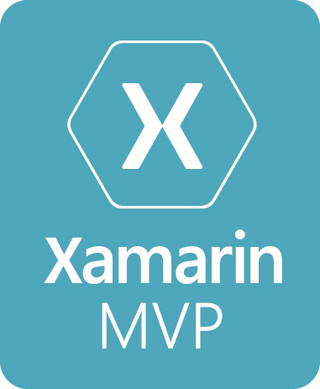


Cross Platform Iot with Visual Studio and Xamarin
Allan Pead
@adpead
Xamarin MVP, Microsoft MVP, Xamarin Insider

Slide 2
The Internet of things (IoT) is the inter-networking of physical devices, vehicles (also referred to as "connected devices" and "smart devices"), buildings, and other items embedded with electronics, software, sensors, actuators, and network connectivity which enable these objects to collect and exchange data.

Slide 3
What is this talk about?
Not an electronics tutorial
http://www.instructables.com/id/Basic-Electronics/
Overview of some devices and see what you can do with them
Learn about a bit about Microsoft tooling and how to harness Xamarin in the Iot space
Wide not deep
Hopefully inspire you to build stuff! ☺

Slide 4
What can I do in Visual Studio?
.NET MF (Micro Framework) (eg. Netduino)
Arduino
Visual Micro
Visual Studio Code (Arduino extension is now Open Source)
Windows 10 Iot Core
Android Things
Xamarin Iot

Slide 5
Demos
Visual Micro: Arduino Leonardo (on a Latte Panda)
Visual Studio Code: Microsoft Arduino Extension
MXChip Arduino Azure Iot Kit

Slide 6
Arduino
Visual Micro: http://www.visualmicro.com/
Visual Studio Code Extension: https://blogs.msdn.microsoft.com/iotdev/2017/07/06/visual-studio-code-extension-for-arduino-is-now-open-sourced/
MXChip Kit: https://microsoft.github.io/azure-iot-developer-kit/

Slide 7
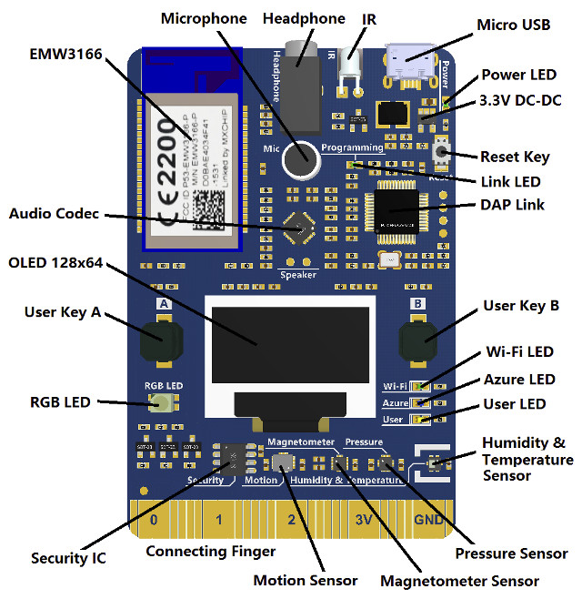

Slide 8


Slide 9
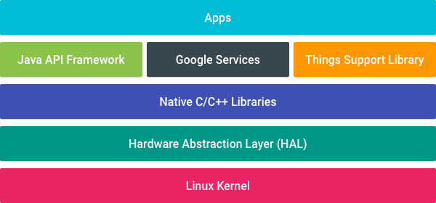
Android Things
Android Things makes developing connected embedded devices easy by providing the same Android development tools, Android framework, and Google APIs
Now in Preview 0.41

Slide 10
Things Support Library
Peripheral I/O API
The Peripheral I/O APIs let your apps communicate with sensors and actuators using industry standard protocols and interfaces. The following interfaces are supported: GPIO, PWM, I2C, SPI, UART.
User Driver API (GPS, HID, Sensors, Audio)
User drivers extend existing Android framework services and allow apps to inject hardware events into the framework that other apps can access using the standard Android APIs.
Notes:
Universal Async Receive tranmit
Serial Peripheral Interface – serial
I2C is a serial bus, master slave
PWM Pulse Width Modulation. GPIO General Purpose Input and output.

Slide 11
Behavioral Changes
Core application packages
Android Things doesn't include the standard suite of system apps and content providers. Avoid using common intents as well as the following content provider APIs in your apps: CalendarContract, ContactsContract, DocumentsContract, DownloadManager, MediaStore, Settings, Telephony, UserDictionary, VoicemailContract
Displays are optional
Google Play Services partially available
Home activity support
Android Things expects one application to expose a "home activity" in its manifest as the main entry point for the system to automatically launch on boot.

Slide 12
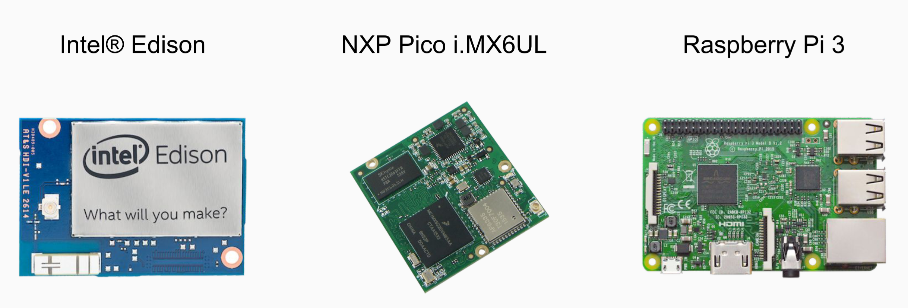
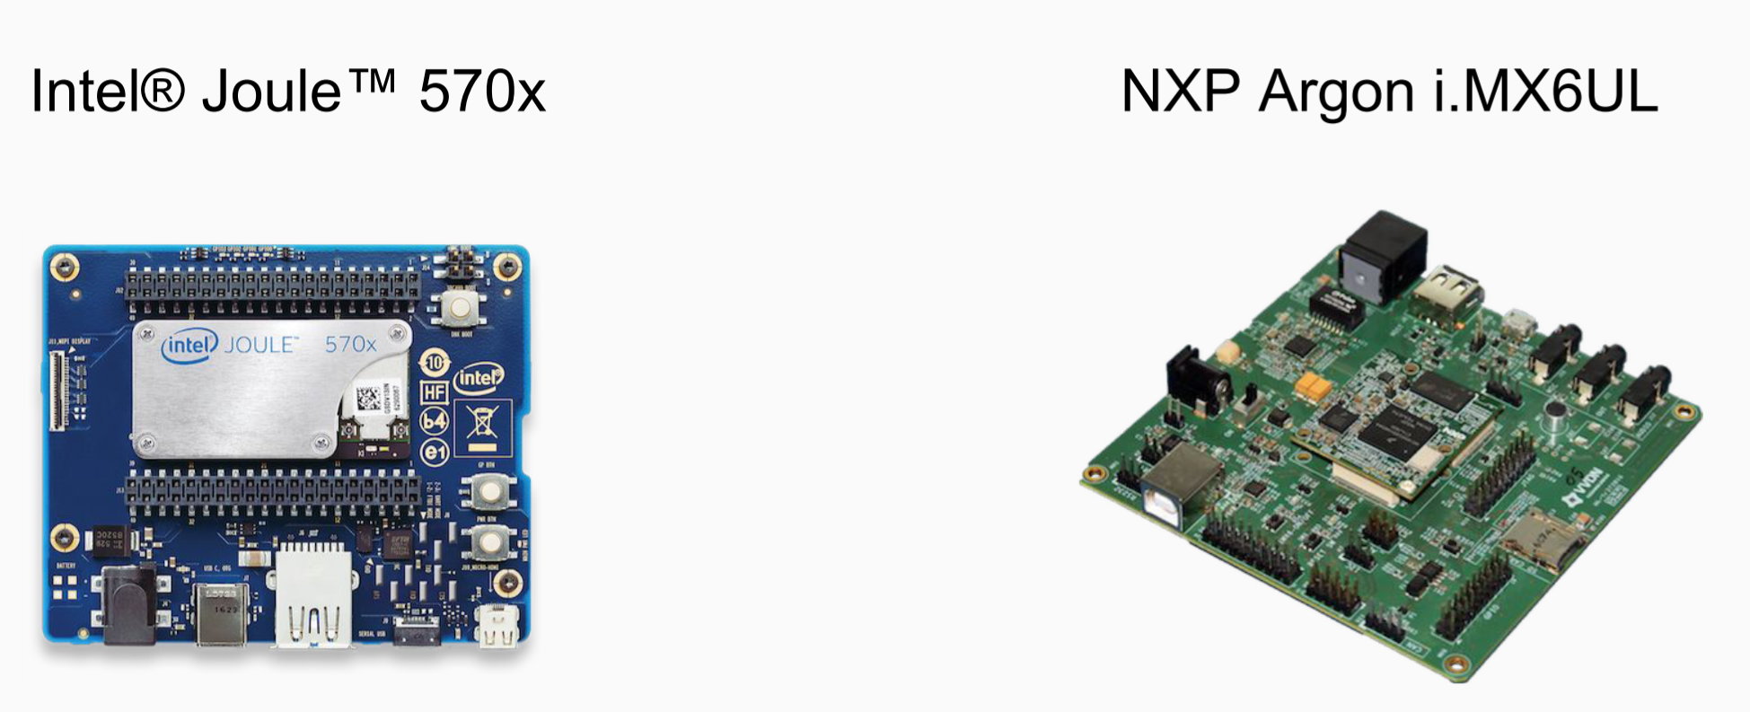
Development Boards

Slide 13
Getting Started
Download: https://developer.android.com/things/preview/download.html
SD Card Reader
8 Gig SD Card
Ethernet Cable (or for headless USB TTL Cable)
HDMI Cable for display
Android Studio or Xamarin.Android (Stable)

Slide 14
Getting Started - Wifi
Adb shell
am startservice \ -n com.google.wifisetup/.WifiSetupService \ -a WifiSetupService.Connect \ -e ssid <Network_SSID> \ -e passphrase <Network_Passcode>

Slide 15
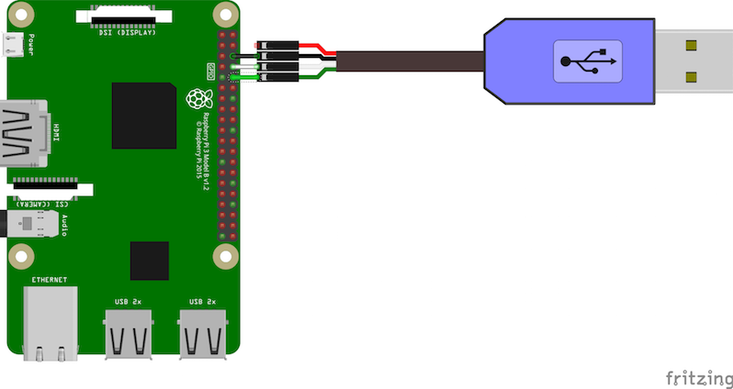
Getting Started – Wifi (Raspberry Pi)
http://www.putty.org/

Slide 16
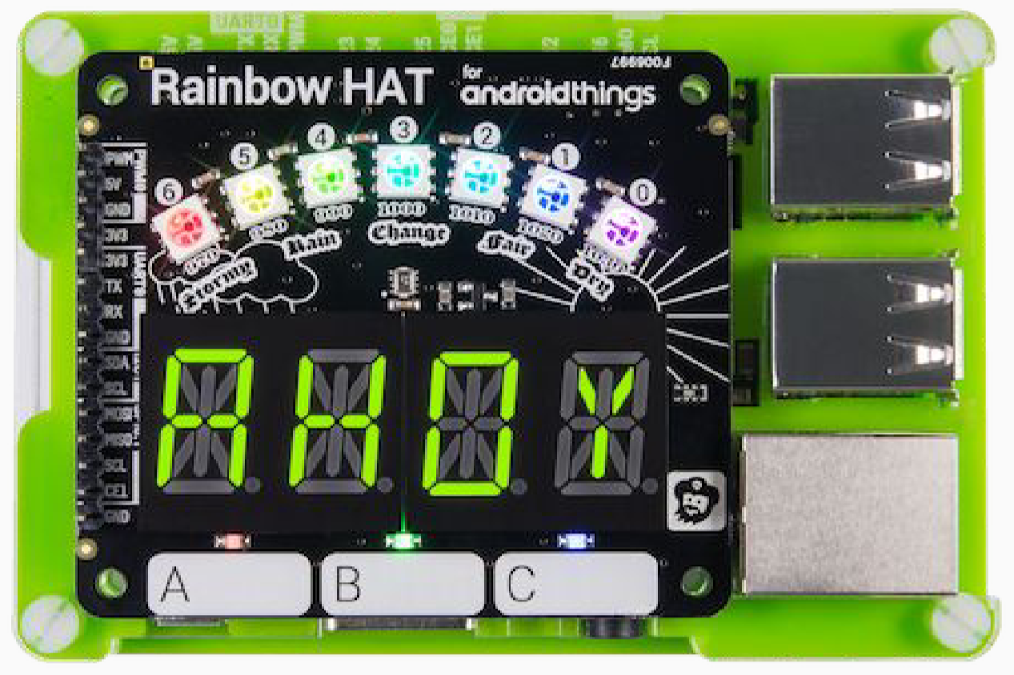
Getting Started
https://shop.pimoroni.com/products/rainbow-hat-for-android-things

Slide 17
Google Contrib Drivers
https://github.com/apead/Xamarin-AndroidThings-Contrib
Things Support Library
Sparkfun ADC Block for Intel Edison - adcv2x
Apa102 RGB LED strip
Bmx280 temperature and pressure sensor
Push button over GPIO
Cap12xx capacitive touch buttons
GPS
Ht16k33 7-digit alphanumeric segment
Mma7660fc accelerometer sensor
PWM speaker/buzzer
Metadriver for the Rainbow HAT
Metadriver for the Sense HAT
Ssd1306 OLED display
Tm1637 4-digit numeric segment display
https://github.com/androidthings/contrib-drivers

Slide 18
Demos
Cross Platform Xamarin Forms - Android Phone, Windows 10 Iot, Android Things
Demo of Android Things with SenseHAT
Android Things Weather Station (RainbowHAT) with Azure Iot Hubs

Slide 19
Xamarin Nuget
Things Support Library
https://www.nuget.org/packages/Xamarin.Android.Things/0.4.0-devpreview
Google Contrib Drivers
https://www.nuget.org/packages/Xamarin.AndroidThings.Contrib.RainbowHat/0.40.0-beta

Slide 20
Xamarin Iot
Iot for all things Linux
Support for devices, not supported by Android Things and Windows 10 Iot
Cross Platform components
Visual Studio 2017 or Visual Studio for Mac

Slide 21
Getting Started
A device with a Linux Distribution
SSH Enabled
Visual Studio 15.3 Preview 3 with Xamarin Out of Band Updater or Visual Studio for the Mac Alpha

Slide 22
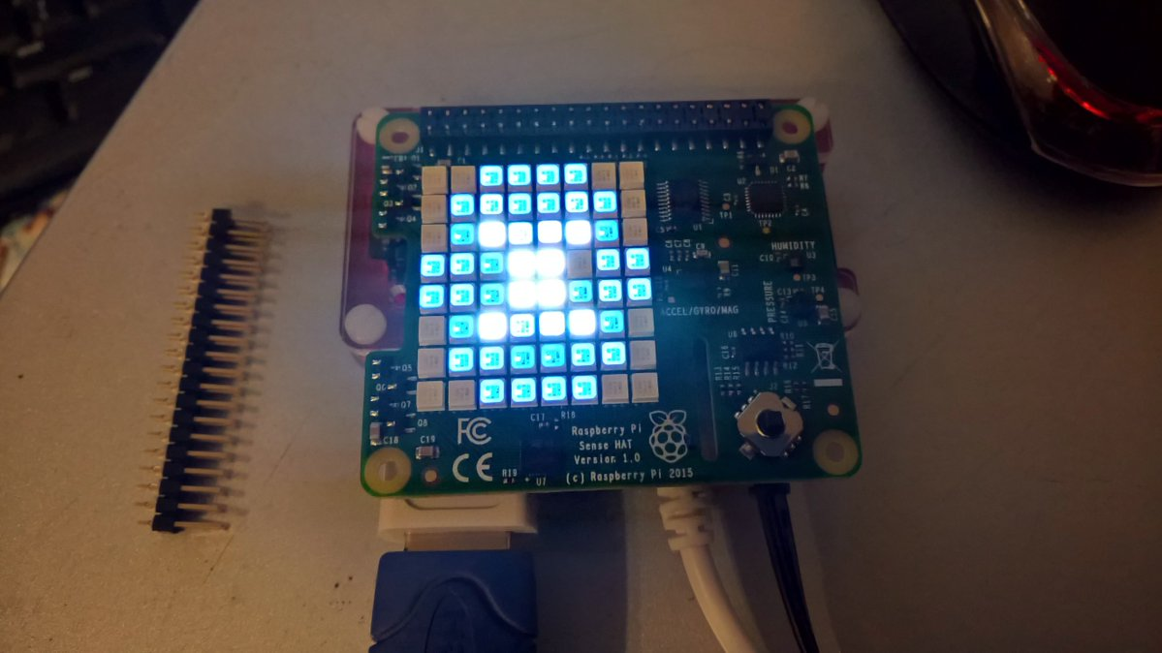
Iot Components

Slide 23
Iot Components
IOT Sharp
https://github.com/xamarin/xamarin-iot-samples/tree/master/IoTSharp.Components
Raspberry Sharp
https://github.com/raspberry-sharp

Slide 24
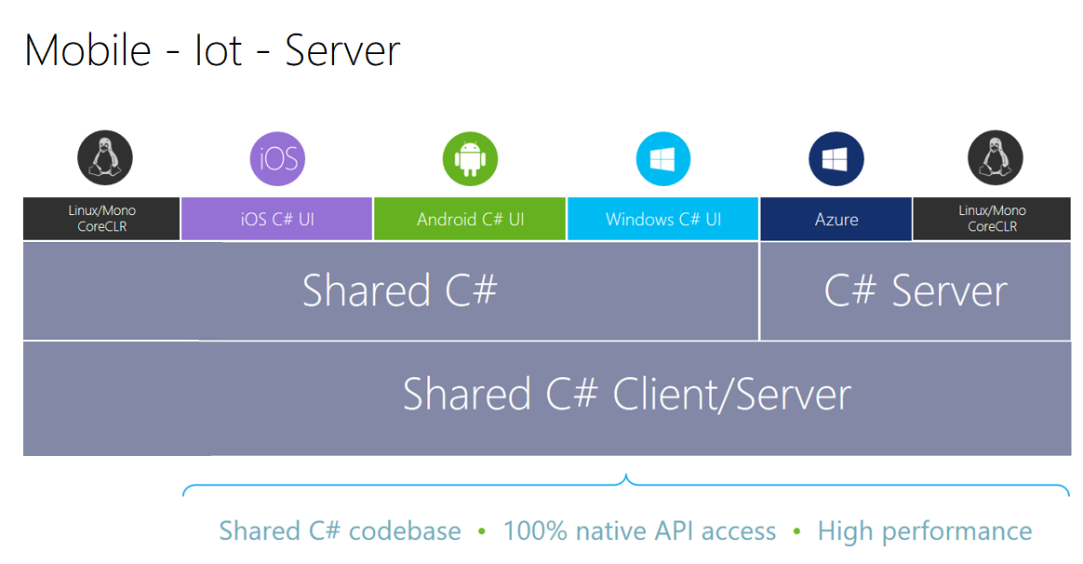

Slide 25
Demos
Xamarin Iot running on a Raspberry Pi Zero W (Raspbian)

Slide 26
Azure Iot Hubs
Establish bi-directional communication with billions of IoT devices
Work with familiar platforms and protocols (standard and custom protocols, including HTTP, Advanced Message Queuing Protocol (AMQP), and MQ Telemetry Transport (MQTT)
Authenticate per device for security-enhanced IoT solutions

Slide 27
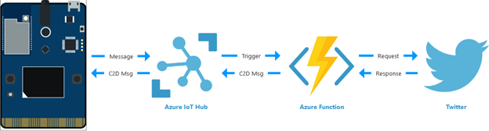
Azure Hubs
https://azure.microsoft.com/en-us/suites/iot-suite/

Slide 28
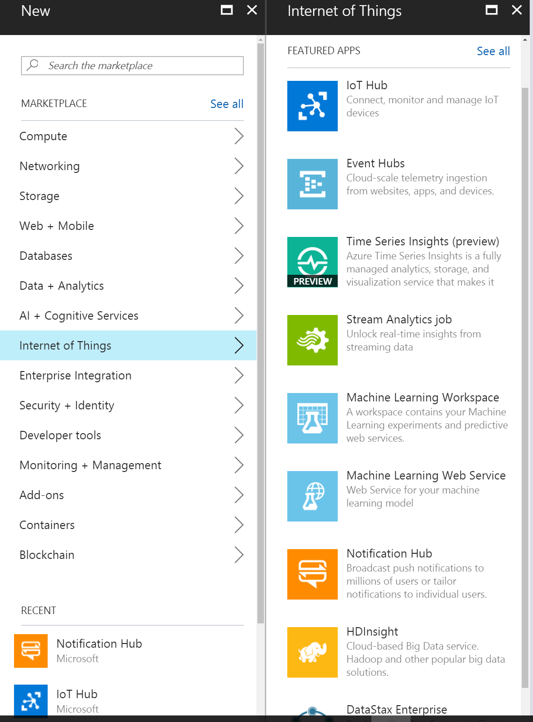
Azure Internet of Things

Slide 29
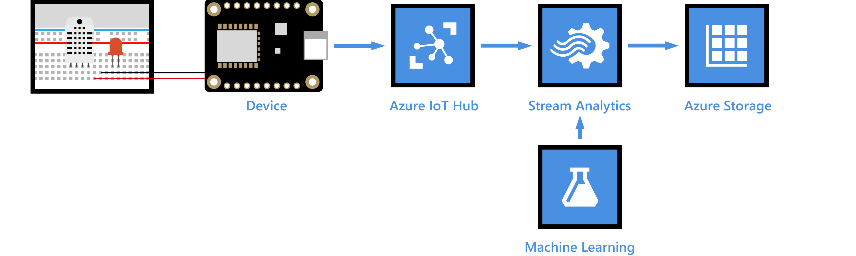
Azure Hubs
https://docs.microsoft.com/en-us/azure/iot-hub/iot-hub-weather-forecast-machine-learning

Slide 30
Learn More about IOT
Android Things
https://developer.android.com/things/hardware/index.html
Xamarin IOT
https://developer.xamarin.com/guides/cross-platform/iot/
Visual Studio Code Arduino Extension
https://marketplace.visualstudio.com/items?itemName=vsciot-vscode.vscode-arduino
Azure Iot Hubs
https://docs.microsoft.com/en-us/azure/iot-hub/

Slide 31
Learn Xamarin
Local Slack Community
https://zatech.slack.com #xamarin
Xamarin Learning Resources
https://developer.xamarin.com/guides/
Xamarin University
https://www.xamarin.com/university
Learn and share with your local community
Xamarin User Groups
Cape Town (@CTXUG)
Johannesburg (@GXUGSA)
Durban (@DXUGSA)
Allan Pead
Xamarin MVP, Microsoft MVP,
Xamarin Insider
Email: adpead@gmail.com
Blog: http://www.explorationspace.co.za
Twitter: @adpead

Slide 32
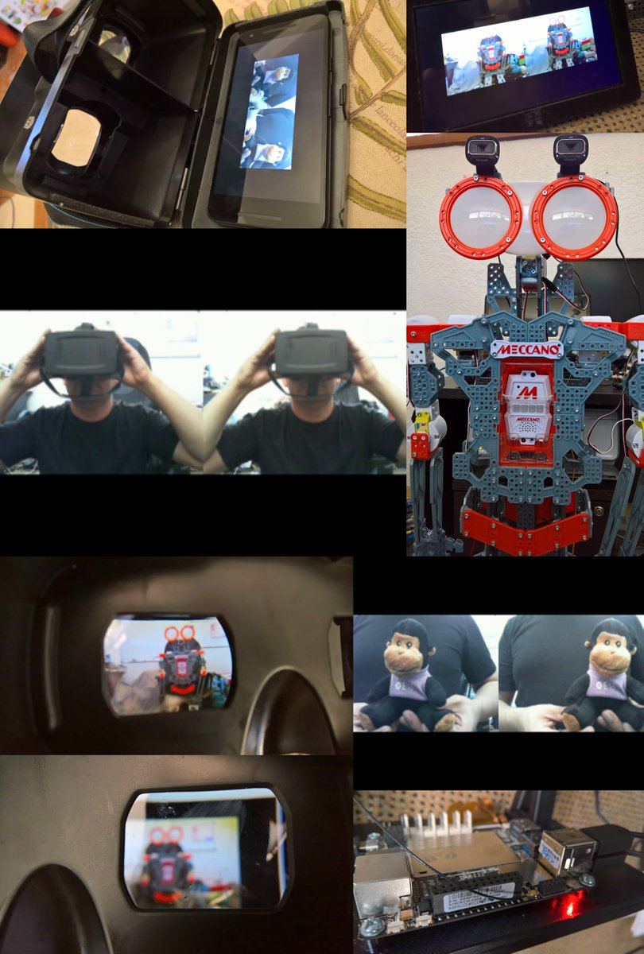
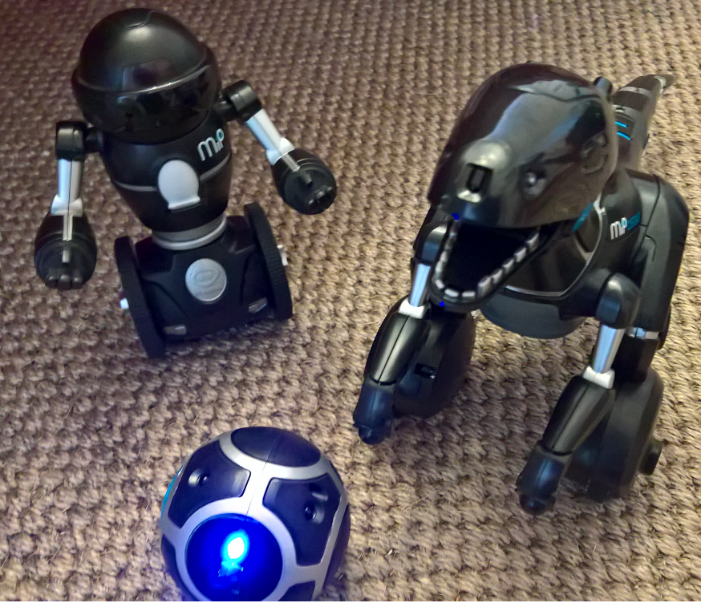
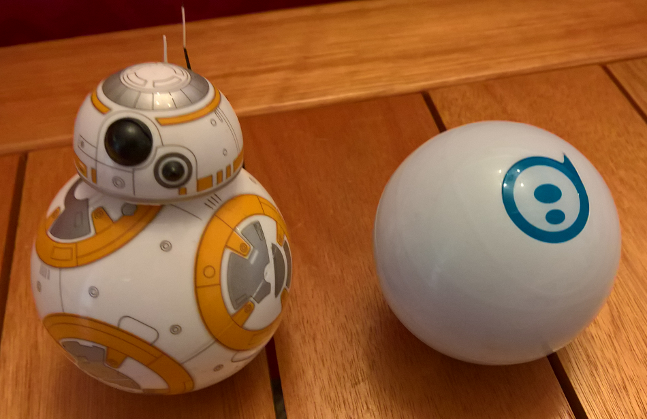
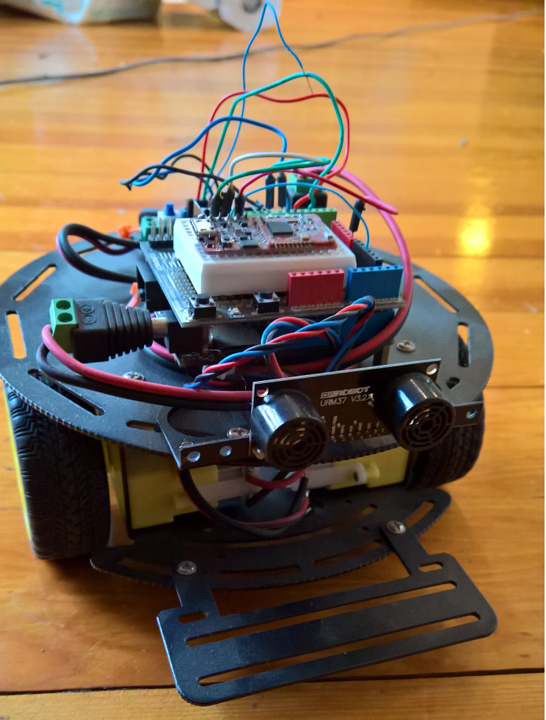
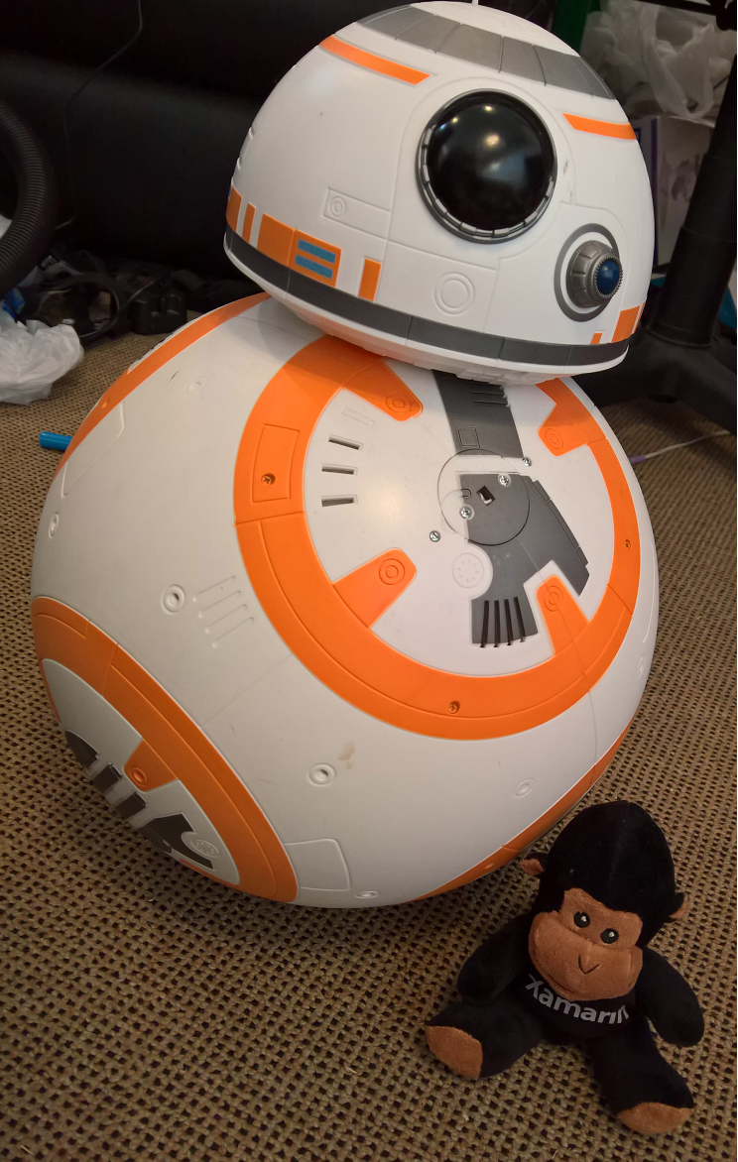
Learn by Play!! Anything is Possible!
Meccadroid – Xamarin.Android, LattePanda, OpenCV, Cognitive Services,
TensorFlow
MIP and Mipsaur. Xamarin Forms, Bluetooth, Monkey Robotics, MipSDK
Sphero – Xamarin Forms, Bluetooth
.NET MF, Xamarin Forms, Bluetooth, Monkey Robotics
BB8, Xamarin Forms, Infrared
100% Native
100% API Access
Anything you can do in Java, Kotlin, Objective C, Swift you can do in C# and Xamarin

